Slide 1
JSP Tag Libraries Tag Libraries JSTL The “Classic” Custom Tag Event Model Custom Tag #JSTL #CustomTag #Dynamic

Slide 2
Review
JSP Standard Actions
jsp:method attribute
Java Beans
jsp:useBean, jsp:setPropety, jsp:getProperty
Scopes: page, request, session, application
Dispatching Mechanisms
jsp:include, jsp:forward, jsp:param
Expression Language – EL
${EL Expression}
Operators, Implicit Objects, Scope Variables
Functions
Coersions

Slide 3
Objectives
How to remove all java code in JSP (View)? Complete the MVC 2 Design Pattern with View
JSTL
How to build the data grid tag library using in JSP?
Tag Libraries
Model
Classical, Simple, and Handles
How to implement the custom Tag Lib and use it in JSP

Slide 4
JSTL JSP Standard Tag Library
Is a new component being offered by the Sun for JSP programming.
A library of predefined tags (by Sun) that provides a set of reusable standard tags that works in the similar manner everywhere
Allows programming using tags rather than scriptlet code JSTL has reusable standard set of tags.
Provides the user with a script-free environment
Are easier for non-programmers & inexperienced programmers
Disadvantages
It adds processing overhead to the server. The tag libraries are compiled into a servlet, which is then executed by the servlet container. The server is added with much more code by the JSTL.
JSTL is also less powerful than the scriptlets as embedded java codes can do everything in JSP pages

Slide 5
JSTL Type of Tag Library
JSP Standard Tag Library (JSTL)
Core Tag Library
EL Functions
SQL Tag Library
I18N & Formatting Tag Library
XML Tag Library

Slide 6
JSTL Core Tag Library
The library contains the tags for looping, expression evaluation, handle flow controls, and basic input and output.
It can be declared by
<%@ taglib prefix=“c” uri= “http://java.sun.com/jsp/jstl/core” %>
General Purpose Tags
Are used to set, remove and display variable values that are created within a JSP page.
The core tag library contains tags for getting, setting and displaying attribute values.

Slide 7
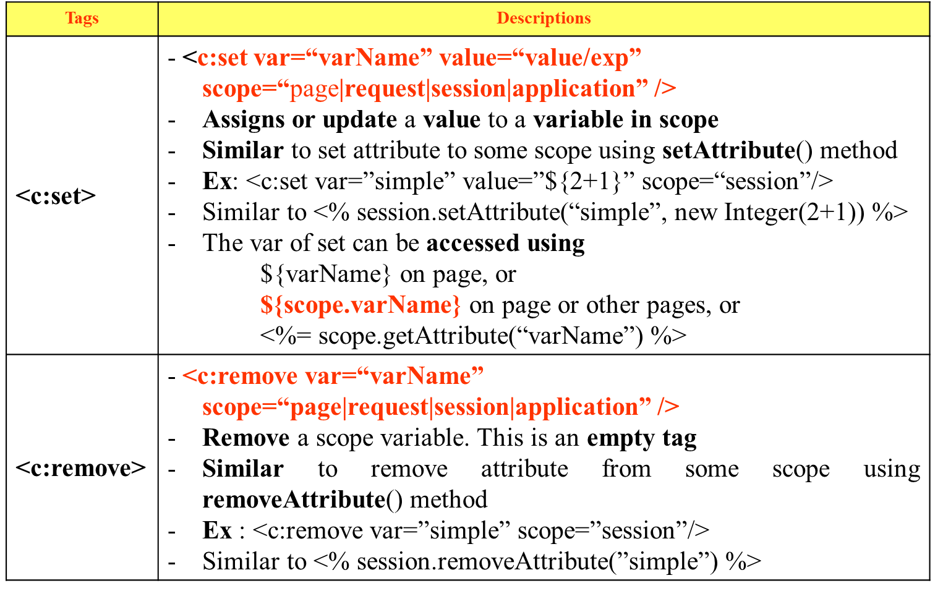
JSTL Core Tag Library – General Purposes

Slide 8
JSTL Core Tag Library – General Purposes
Tags | Descriptions
<c:out> | - <c:out value=“value|expression” escapeXml=“true|false” default=“defaultValue” /> Evaluate an expression & store the result in the current JspWrite object Default value if the resulting value is null Similar to print out the data using out object in JSP Implicit Object Ex: <c:out value=”${simple}”/> similar to <%= pageContext.getAttribute(simple) %>
<c:catch> | - <c:catch [var=”varName”]>…</c:catch> - Provides an exception handling functionality, such as try-catch, inside JSP pages without using scriptlets

Slide 9
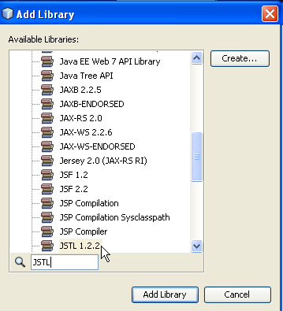
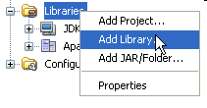
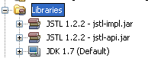
JSTL Requirement
Required Library for JSTL
JSTL 1.2.2 (jstl-impl.jar, jstl-api.jar)
Choose JSTL 1.2.2

Slide 10
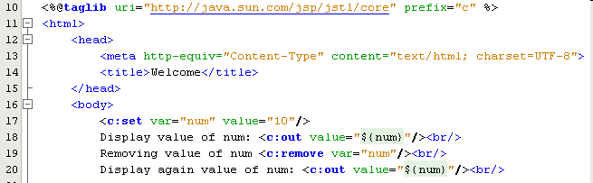
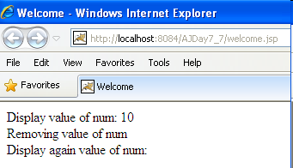
JSTL Core Tag Library – Example

Slide 11
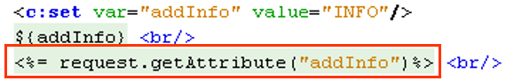
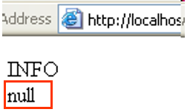
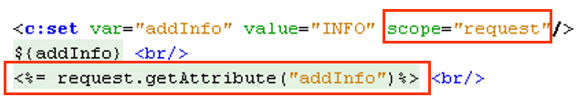
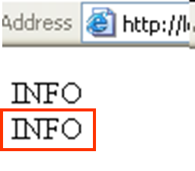
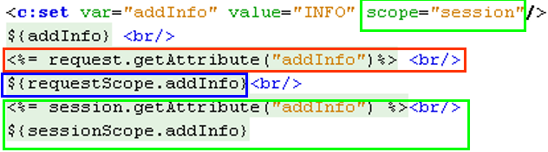
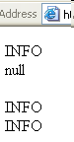
JSTL Core Tag Library – Example

Slide 12
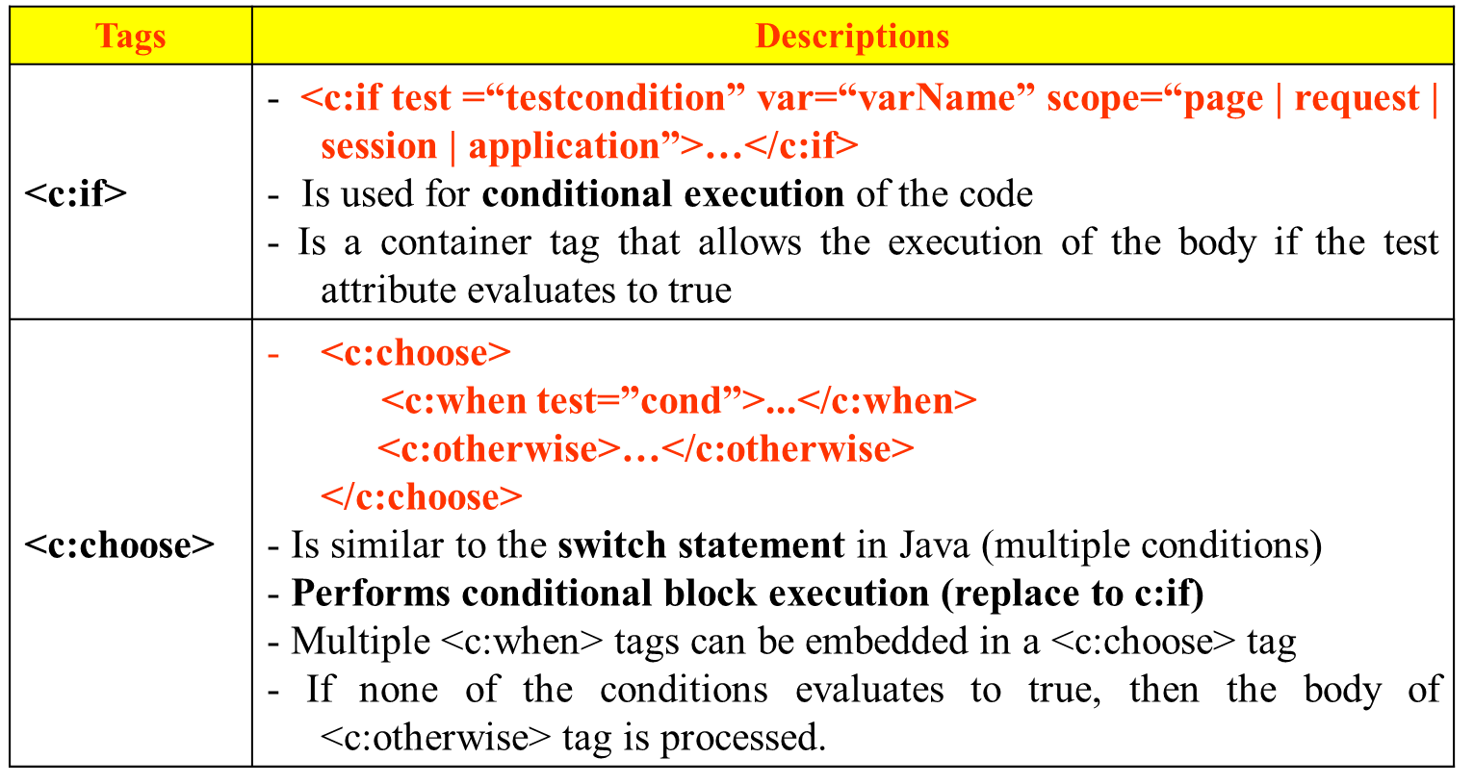
JSTL Core Tag Library – Decision Making
Support conditions in a JSP page
Are necessary as the contents or the output of the JSP page is often conditional based on the value of the dynamic application data

Slide 13
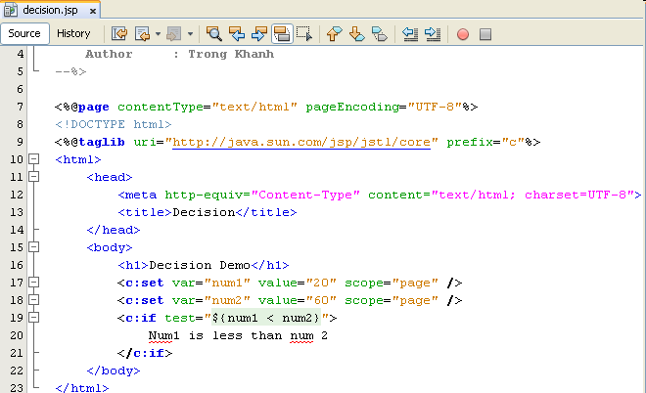

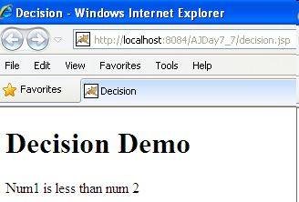
JSTL Core Tag Library – Example

Slide 14
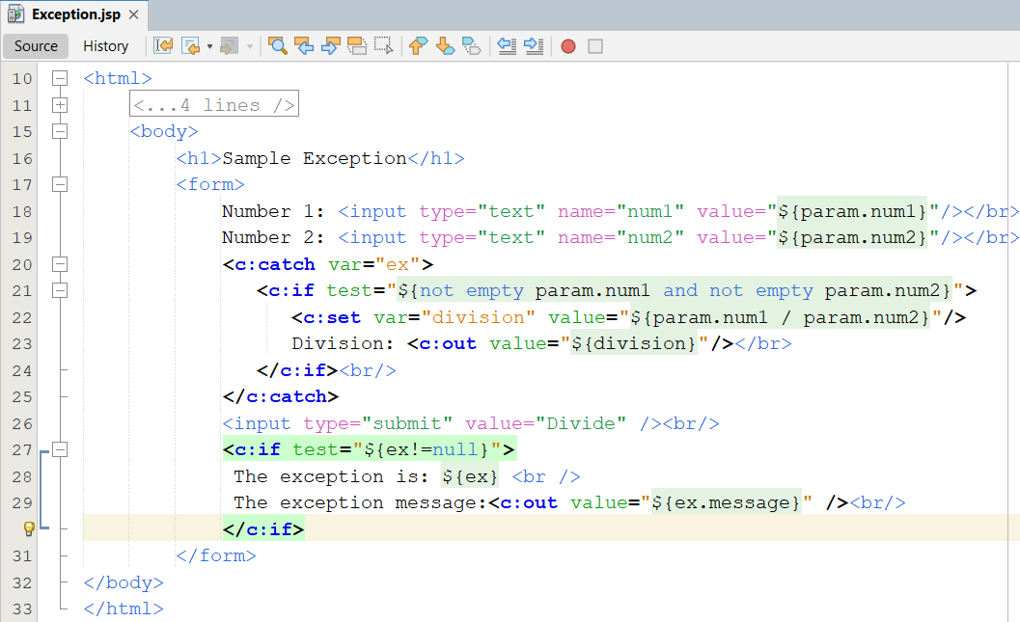
JSTL Core Tag Library – Example

Slide 15
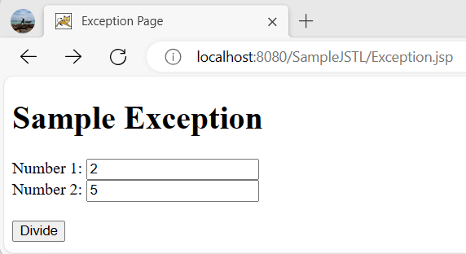
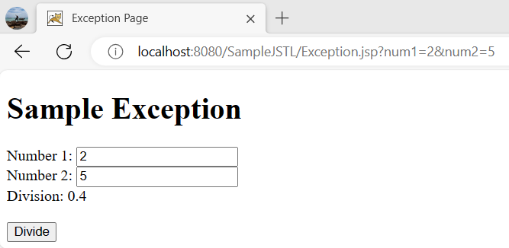
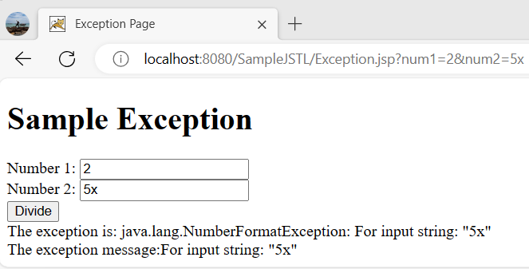
JSTL Core Tag Library – Example
111
121
131
Notes:
<%@ taglib prefix = "fmt" uri = "http://java.sun.com/jsp/jstl/fmt" %>
<fmt:formatNumber type="number" minFractionDigits="2"
maxFractionDigits="2"
value="${division}"/>

Slide 16
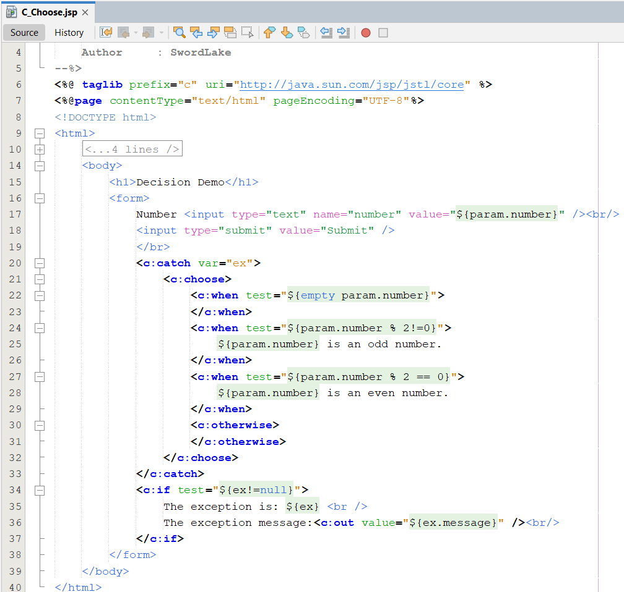
JSTL Core Tag Library – Example

Slide 17
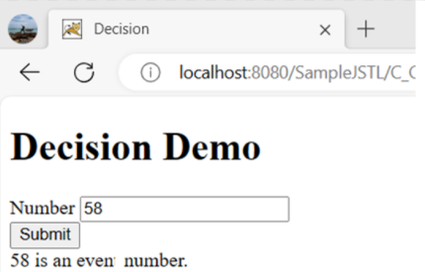
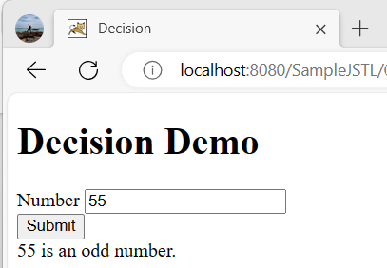
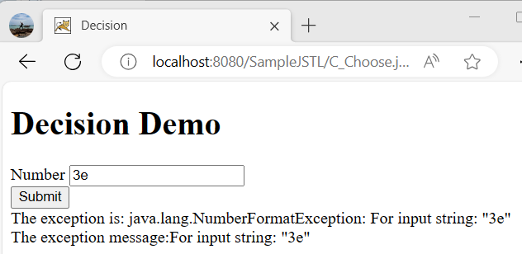
JSTL Core Tag Library – Example

Slide 18
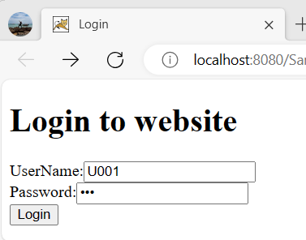
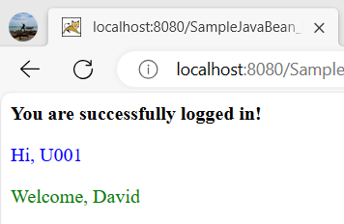
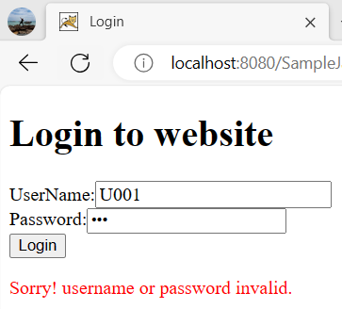
JSTL & EL Example

Slide 19
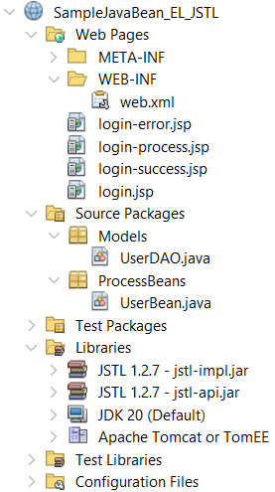
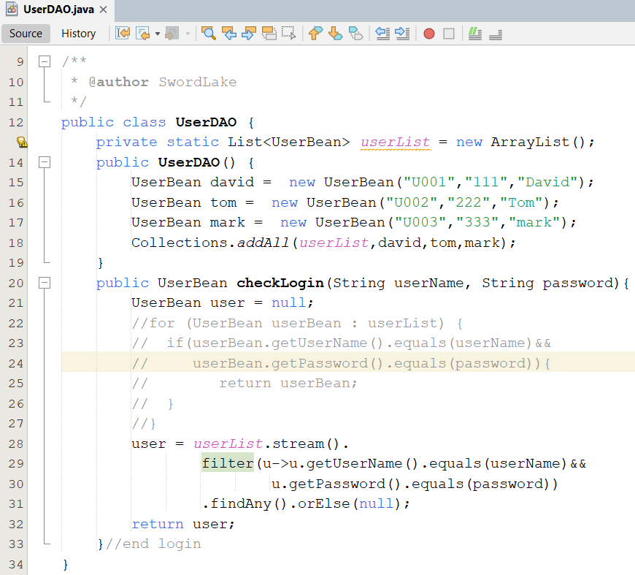
JSTL & EL Example
111

Slide 20
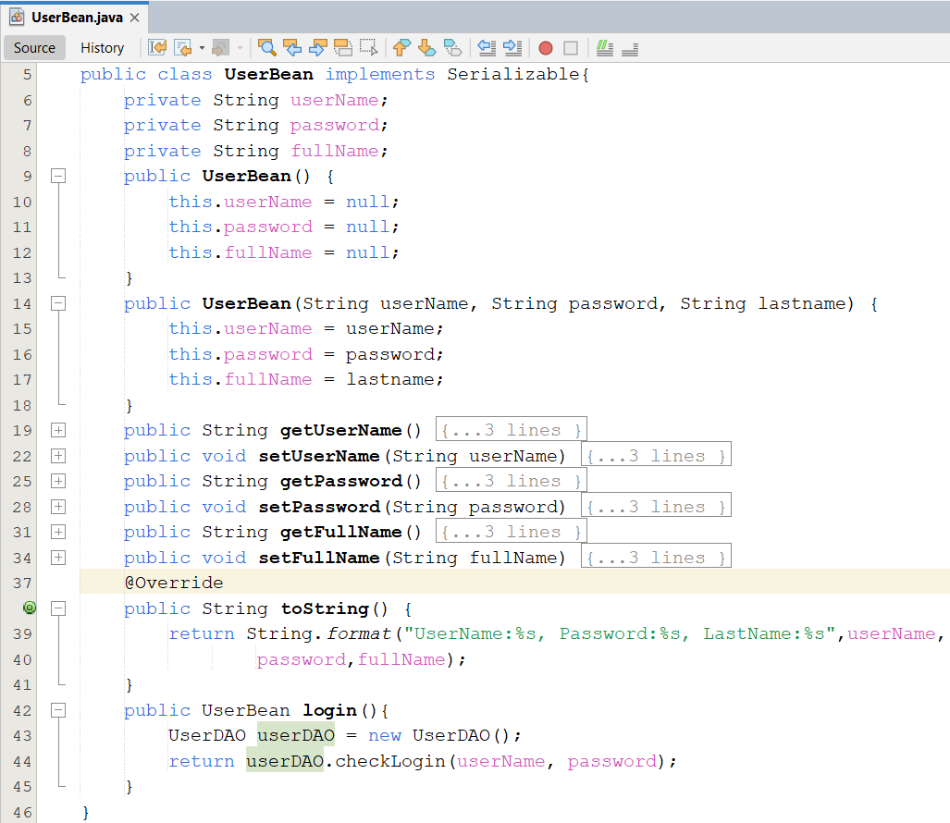
JSTL & EL Example
121

Slide 21
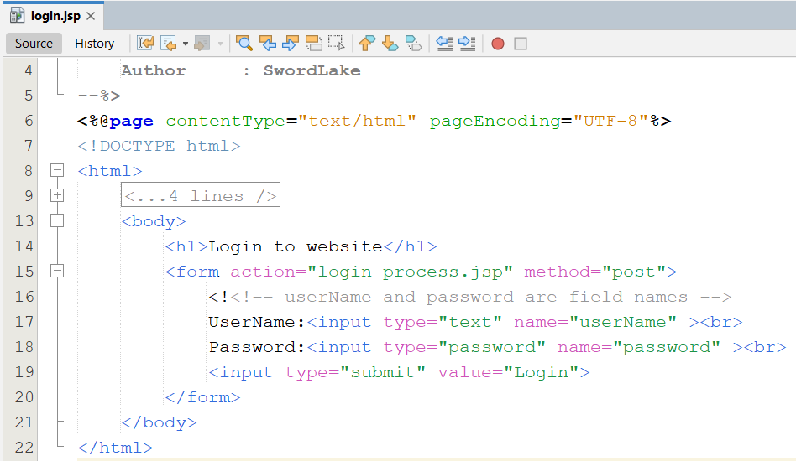
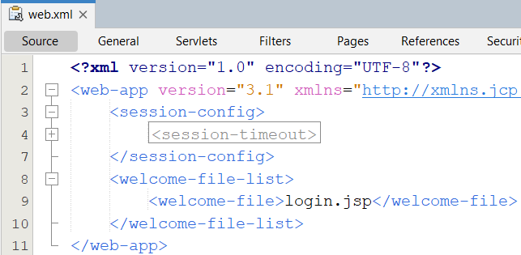
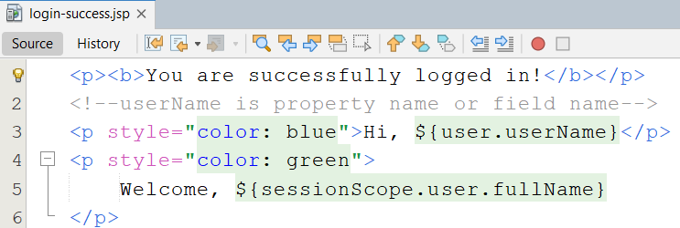
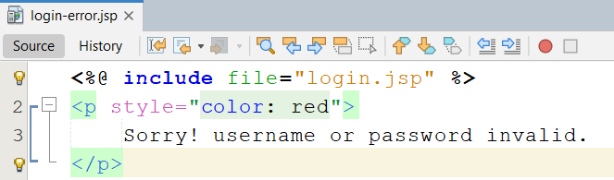
JSTL & EL Example
131
4
161
151

Slide 22
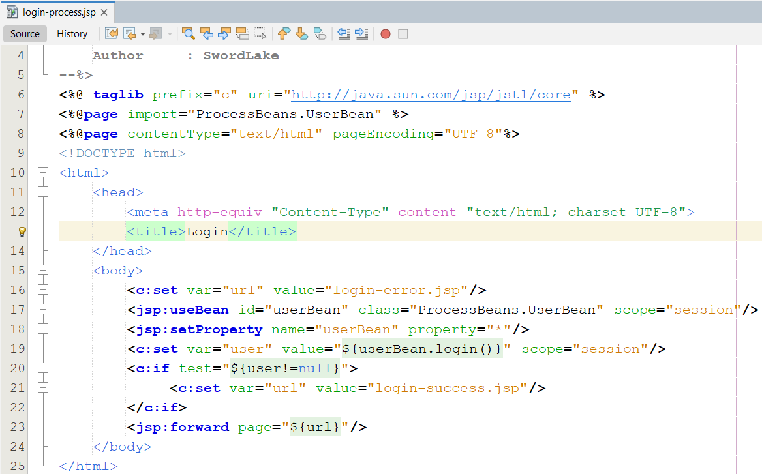
JSTL & EL Example
171

Slide 23
JSTL Core Tag Library – Iterations
Is required for performing looping function
The object can be retrieved from a collection in the JavaBeans component and assigned to a scripting variable by using iteration tags
Tags | Descriptions
<c:forEach> | - <c:forEach var=“varName” items=“collection” begin=“begin” end=“end” step=“step” varStatus=“internalLoopobject”>…</c:forEach> - Is used repeat the body content over a collection of objects Will continue for a number of times specified by the user in the code varStatus’s methods: count (int), current (obj), index (int)
<c:forTokens> | -<c:forTokens items=“stringofToken” delims=“delimiters” var=“varName” >...</c:forTokens> - Is used to iterate over a collection of tokens separated by user-specified delimiters - It is a container tag

Slide 24
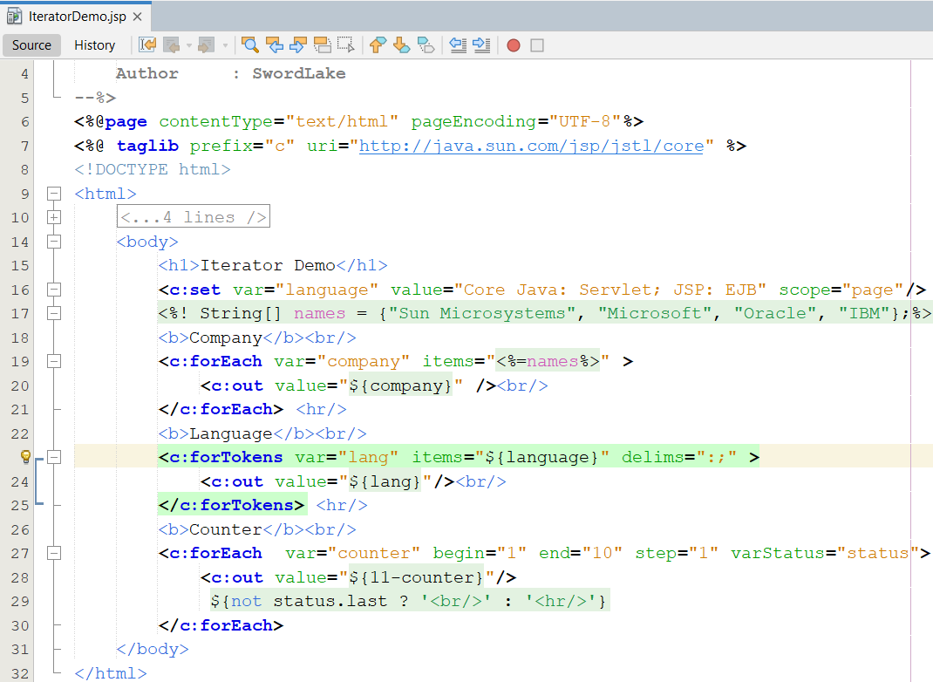
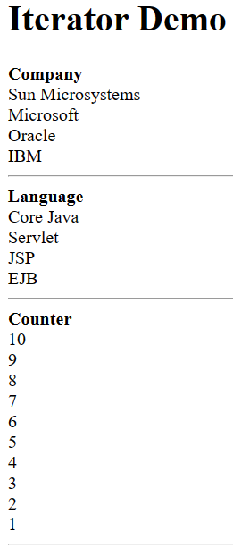
JSTL Core Tag Library – Example

Slide 25
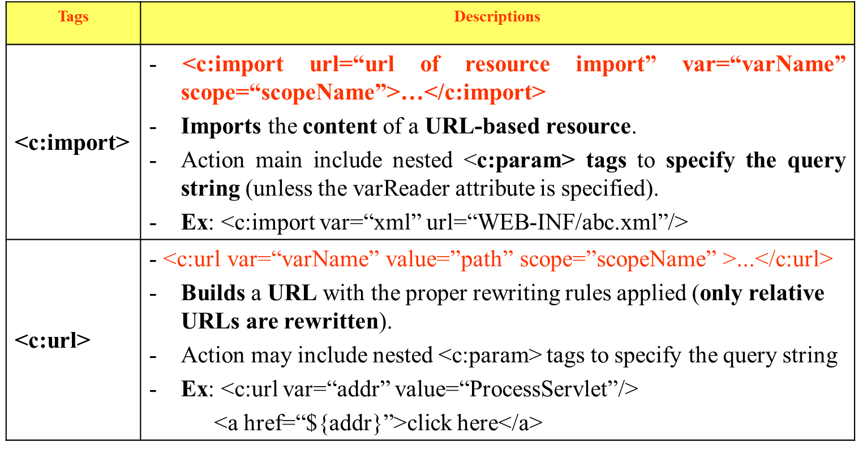
JSTL Core Tag Library – URL-Related Actions
Are used to import resources from a given URL, re-encode URLs, redirect to URLs, as well as pass additional request parameters where necessary

Slide 26
JSTL Core Tag Library – URL-Related Actions
Tags | Descriptions
<c:redirect> | <c:redirect url=“url path”>…</c:redirect> Sends the client a response to redirect to the specified URL. This action willabort processing of the current page. Action may include nested <c:param> tags to specify the query string. Ex: <c:redirect url=“abc.jsp”/>
<c:param> | <c:param name=“nameOfQuery” value=”ValueOfParameter”>...</c:param> Adds request parameters to a URL. This action can only be nested within <c:import>, <c:url>, or <c:redirect>

Slide 27
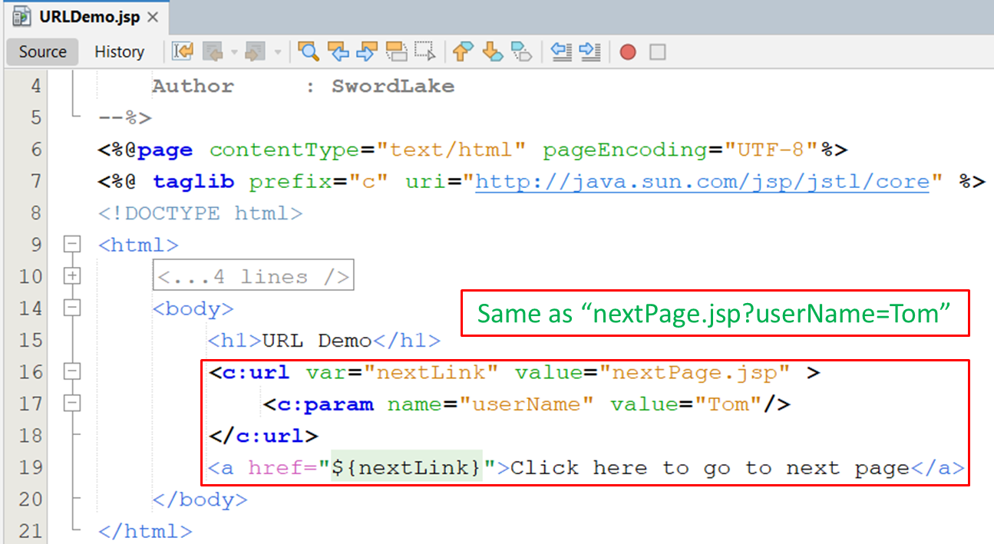
JSTL Core Tag Library – URL-Related Actions
111

Slide 28
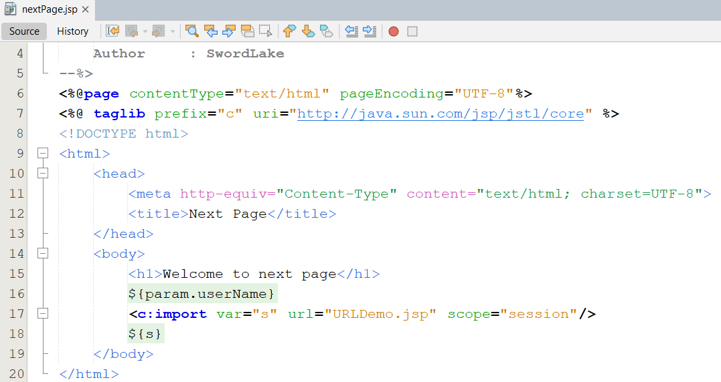
JSTL Core Tag Library – URL-Related Actions
2

Slide 29
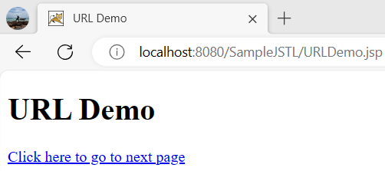
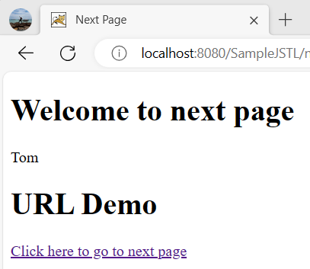
JSTL Core Tag Library – URL-Related Actions

Slide 30
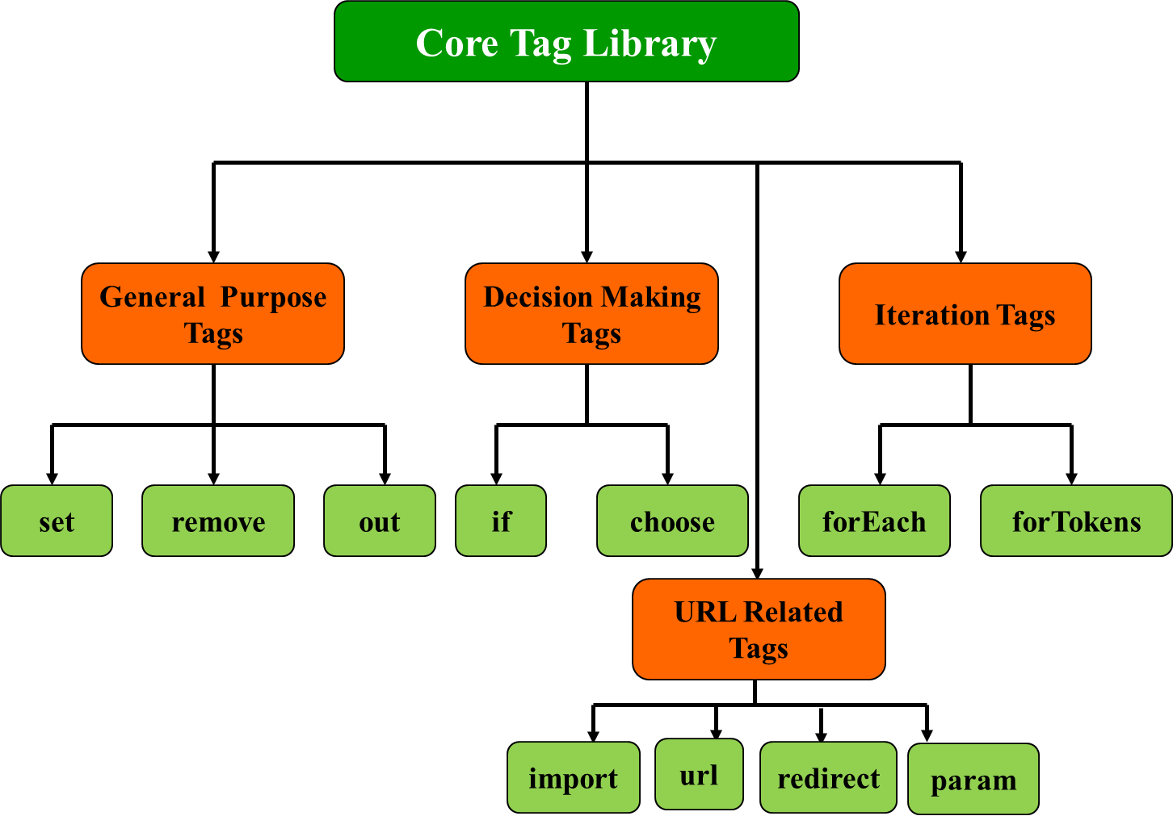
JSTL Core Tag Library – Summary

Slide 31
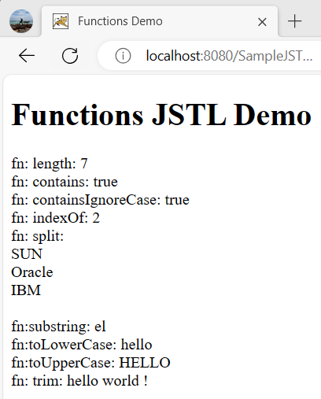
JSTL Functions Tag Libraries
The library contains tags, which provides the utility functions in process on jsp page combining jstl
All functions treat null Strings as empty Strings
It can be declared by
<%@ taglib prefix=“fn” uri=”http://java.sun.com/jsp/jstl/functions” %>
Some functions
fn:length
fn:contains
fn:containsIgnoreCase
fn:indexOf
fn:split
fn:trim
fn:substring
…

Slide 32
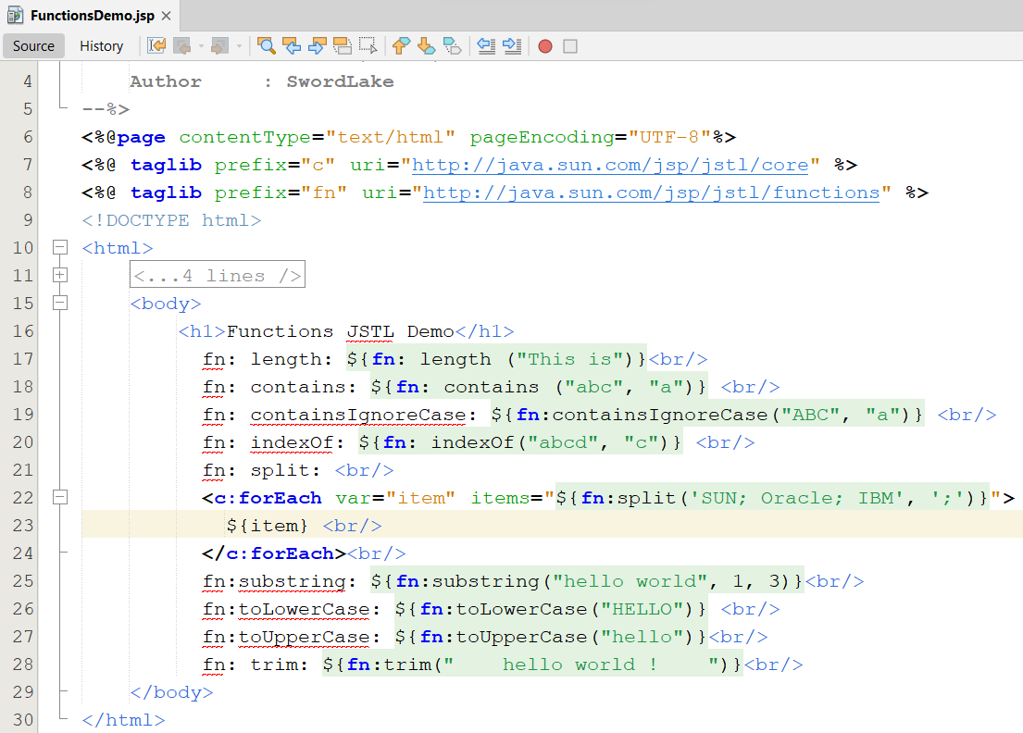
JSTL Functions Tag Libraries

Slide 33
JSTL SQL Tag Library
The library contains tags, which are used to access SQL databases, are used to perform the database related tasks, such as selection, insertion, deletion and modification without using java codes
It provides an interface for executing SQL queries on database through JSP.
It can be declared by
<%@ taglib prefix=“sql” uri=”http://java.sun.com/jsp/jstl/sql” %>
The “setDataSource” Tag
Is used to set a data source for the database.
Is an empty tag and allows the user to set data source information for the database
Syntax:
<sql:setDataSource dataSource=“datasource” | url=“jdbcurl” driver=“jdbcclassdriver” user=“username” password=“password” var=“varName” scope=“page | request | session | application” />
If the DataSource attribute is used, then url attribute cannot be used.

Slide 34
JSTL SQL Tag Library
The “query” Tag
Searches the database and returns a result set containing rows of data. (Passing database queries function)
The tag can either be an empty tag or a container tag.
The SELECT statement is used to select data from the table.
Syntax
<sql:query var=“varName” dataSource=“datasource” scope=“page | request | session | application”>
SQL Statement
<sql:param value=“value” />
</sql:query>
The “update” Tag
Executes the INSERT, UPDATE AND DELETE statements.
Zero is returned if no rows are affected by statements
Syntax
<sql:update var=“varName” dataSource=“datasource” scope=“page | request | session | application”>
SQL Statement
<sql:param value=“value” />
</sql:update>

Slide 35
JSTL SQL Tag Library
The var attribute of query Tag
Is javax.servlet.jsp.jstl.sql.Result interface
Methods
columnNames: Returns the names of the columns in the result
rowCount: Returns the number of rows in the cached ResultSet
rows: Returns the result of the query as an array of SortedMap objects
rowsByIndex: Returns the result of the query as an array of arrays
limitedByMaxRows: Returns true if the query was limited by a maximum row setting

Slide 36
JSTL SQL Tag Library
The “transaction” Tag
Is used to established a transaction context for <sql:query> and <sql:update> tags.
The connection object is obtained from <sql:transaction> as this tag is responsible for managing access to the database.
Syntax
<sql:transaction dataSource=“datasource” isolation=“isolationLevel”>
<sql:update> or <sql:query> Statements
</sql:transaction>
The “param” Tag
Is used to set values for parameters markers (“?”) in SQL statements.
It acts as a sub tag for <sql:query> and <sql:update>
Syntax
<sql:param value=”value”/>

Slide 37
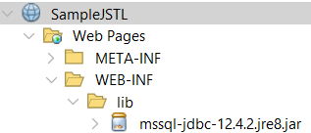
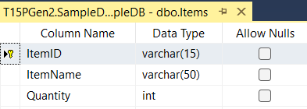
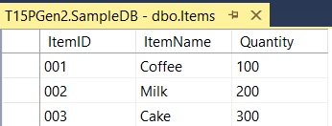
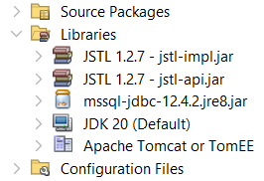
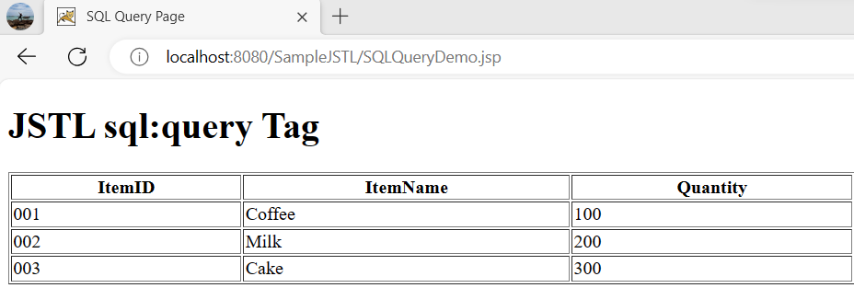
Build Library Tag Lib Library Requirements
Build the data grid tag library using in JSP as

Slide 38
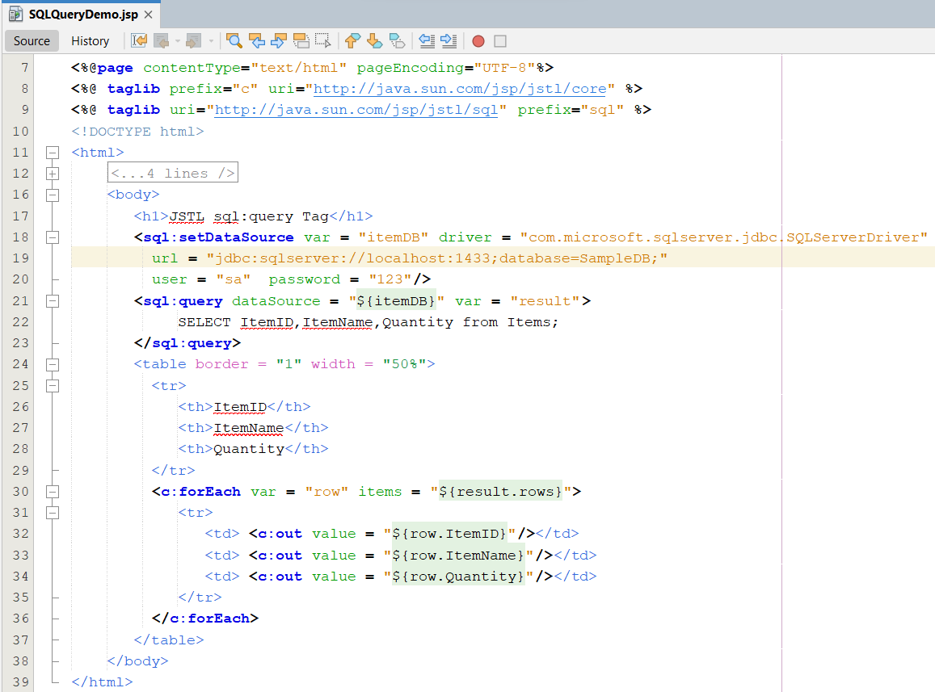
JSTL SQL Tag Library – Example

Slide 39
JSTL SQL Tag Library
SQL Tag Library
setDataSource
query
update
transaction
param

Slide 40
Tag Libraries Tag Extension Mechanism
Enables creation of custom tags
Java code can be avoided using custom tags
Separates the work profiles of Web designers and developers (representation and business logic)
Custom tags can be reused
Written using XML syntax
Encapsulation
Components of custom tag
Tag Library Descriptor (TLD): an XML document contains information about the contents of a tag library.
Custom Action: a Java class implements the contents in the TLD
Web deployment descriptor: locate the custom tag library to use
A Tag is implemented through extending some interfaces of the javax.servlet.jsp.tagext package

Slide 41

Tag Libraries Tag Extension Mechanism

Slide 42
Tag Libraries Terminologies
Classic custom tag is defined by the classic tag handler class.
Simple custom tag is defined by the simple tag handler classes.
Basic tags
Generally do not contain any body. (Even if it contains body, the body is not processed by the tag.)
The tag handler class of the basic tag implements the Tag interface and extends the TagSupport class.
Iteration tags
Are valuated time and again.
Are generally empty tags.
The tag handler class for an iteration tags needs implementation of IterationTag interface that extends the Tag interface.
Complex tags
Support evaluation of the body content of the tag including other services provided in the basic tag or iteration tag.
Implement BodyTag interface and extend the BodyTagSupport class.
Notes:
-Terminologies : thuật ngữ
JSP cung cấp cho chúng ta cách thức tạo tag sử dụng 03 loại
Classic Custom Tag: người dùng phải implement tất cả các phương thức callback theo định nghĩa trong interface kể cả khi các phương thức không dùng
Simple Custom Tag: người dùng chỉ tập trung vào phần xử lý của tag mà không quan tâm đến các phương thức mặc định của các interface định nghĩa. Về mặt người dùng thì cơ chế này đơn giản cho người dùng nhưng về tính hiệu quả uyển chuyển thì Class Custom Tag tốt hơn nhưng đòi hỏi vận dụng phức tạp và phải nắm bắt đầy đủ các kiến thức về tag lib
Tag File: 02 cơ chế trên gặp phải nhược điểm là vẫn phải viết java class cùng với việc cài đặt code, do vậy, trở nên không uyển chuyển với người phát triển và đặc biệt khó để kết hợp và sử dụng các tag lib sẵn có để nhằm mục đích tích hợp lại. Cho nên, tag file là cách thức tạo tag lib tương tự như tạo trang JSP, người dùng có thể tích hợp các tag lib sẵn có, sử dụng các thành phần mà JSP qui định để hỗ trợ xử lý và đặc biệt không cần biên dịch trước khi sử dụng bởi vì nó sẽ được biên dịch khi được yêu cầu. Điều này có nghĩa là việc vận dụng tag lib trở nên rất uyển chuyển

Slide 43

Tag Libraries Terminologies

Slide 44
Tag Libraries Custom Tags
Allow Java programmer to embed Java codes in JSP documents
Helps the developer reducing the overhead of writing the same business logic again for a particular action to be repeated in programs
Supporting the front end, developer need not bother about the complexity of the logic of a tag because the tag is created by a Java developer and the front end developer only imports it to the JSP page.
Provide a mechanism to reuse and encapsulate complex recurring code or tasks in JSP
Provide simplicity and reusability of Java code
Custom tag body can include static text, HTML, and JSP elements like scriptlets, between the start and the end tag
Notes:
-bother : làm phiền , quấy rầy

Slide 45
Tag Libraries The Custom Tag Development Process
There are 4 essential steps to writing a custom tag
Create a Tag Library Descriptor (.tld) – TLD file
Is an XML document that is used to validate the tags.
Contains the information on each tag available in the library
Provides the JSP engine with meta-information about the custom tag and about its implementation
Contains the list and description of all custom tags in the library
Usually locates at the tlds folder inside WEB-INF directory
Create a Tag Handler class in proper package with .tld file
Is a Java class that defines a tag described in the TLD file.
What a tag will implement depends on what methods can be called and what is required to be implemented.
These are of two types, classic and simple.
Provide details of where to find the TLD file in web.xml (option – required if the .tld files don’t put at the WEB-INF/tlds directory)
Creating a JSP page that will access the custom tags: using a taglib directive in the page before any custom tag is used.

Slide 46
Tag Libraries The TLD file
<?xml version="1.0" encoding="UTF-8"?>
<taglib version="2.0" xmlns="http://java.sun.com/xml/ns/j2ee" xmlns:xsi="http://www.w3.org/2001/XMLSchema-instance" xsi:schemaLocation="http://java.sun.com/xml/ns/j2ee web-jsptaglibrary_2_0.xsd">
<tlib-version>1.0</tlib-version>
<short-name>shortName-prefix</short-name>
<uri>/WEB-INF/tlds/CustomTag</uri>
<tag>
<name>tagName-method</name>
<tag-class>TagHandlerName</tag-class>
<body-content>JSP|EMPTY|scriptless|tagdependent</body-content>
<attribute>
<name>attributeName</name>
<required>false/true</required>
<rtexprvalue>false/true</rtexprvalue>
</attribute>
</tag>
/<taglib>

Slide 47
Tag Libraries Mapping TLD file in web.xml
<web-app>
…
<jsp-config>
<taglib>
<taglib-uri>tld file name</taglib-uri>
<taglib-location>tld location path</taglib-location>
</taglib>
</jsp-config>
…
</web-app>
Ex:
<taglib>
<taglib-uri>CustTags-taglib.tld</taglib-uri>
<taglib-location>/WEB-INF/classes/CustTags-taglib.tld</taglib-location>
</taglib>

Slide 48

Tag Libraries Hunting the Tag

Slide 49
Tag Libraries The Tag Libraries
Is a collection of custom tags
Allows the developer to write reusable code fragments, which assign functionality to tags
The reference to each tag is stored in the tag library
When a tag is used in a JSP page, the taglib directive must be imported as
<%@ taglib uri=“/WEB-INF/tlds/TagHandler” prefix=“u” %>
Locating TLD File: after iterating with the <@%taglib…> directive, traces the location of the tag library descriptor file (through URI) and subsequently to the location of the tag handle class
Associating URIs with TLD File Locations: The uri attribute is mapped to the .tld file by two methods
Implicit
By referring to the tag library descriptor from the expanded WEB-INF folder.
By referring to a JAR file containing a tag library.
Explicit: By defining reference to the tag library descriptor in the deployment descriptor, web.xml of the Web application

Slide 50
Tag Libraries The Tag Libraries
Tag Library Prefix
Distinguish these tags from one another, they are named uniquely by using prefix attributes in the taglib directive
Is used as a reference by the container to invoke its respective TLD file and tag handler class
The value of prefix and the sub element <short-name> inside the <taglib> within the TLD file should match
Notes:
The tld files can be mapped in implicit (e.g. they should be put at the WEB-INF/tlds)
The tld files can be packaged into a jar file, and the tld files within the jar file must have a path that begins /META-INF directory
The tld files must contain the optional <uri> element, which must match the uri of the taglib directive or the namespace value

Slide 51

The “Classic” Custom Tag Event Model Basics
Tag Interfaces and Classes in javax.servlet.jsp.tagext

Slide 52

The “Classic” Custom Tag Event Model Basics
Uses a tag handler class, which implements Tag, IterationTag and BodyTag interfaces or extends the classes TagSupport or BodyTagSupport

Slide 53

The “Classic” Custom Tag Event Model Tag Interface

Slide 54

The “Classic” Custom Tag Event Model Tag Interface

Slide 55
The “Classic” Custom Tag Event Model Iteration Tag Interface
Is implemented to the tag handler class to create tags, which repeatedly evaluates the body inside it.
Is an extension of the Tag interface
Methods | Descriptions
doAfterBody | - public int doAfterBody() throws JSPException - Allows the user to conditionally re-evaluate the body of the tag. - Is invoked after evaluating the body of the tag. - Returns the constant SKIP_BODY or EVAL_BODY_AGAIN. - If the doStartTag() method returns EVAL_BODY_INCLUDE then this method returns EVAL_BODY_AGAIN. - Then the doStartTag() is evaluated once again, but when the doAfterBody() returns SKIP_BODY, the doEndTag() method is invoked

Slide 56


The “Classic” Custom Tag Event Model Iteration Tag Interface
Notes:
Setting the Context
The first thing that happens is that the contextual information (the PageContext and parent Tag) is passed to the tag handler instance.
The Start Tag
After the context has been set, the doStartTag() method is called and one of two things can happen. First, the doStartTag() method can return SKIP_BODY, meaning that the body content is ignored and processing proceeds to the doEndTag() method as before. Alternatively, a value of EVAL_BODY_INCLUDE can be returned from the doStartTag() method, signaling to the JSP container that the body content should be evaluated and included in the page. Again, this is the same as with the Tag interface, although it's after the body content has been evaluated that things start to change.
After the Body
After the body content has been evaluated, the new doAfterBody() method is called, the primary purpose of which is to determine whether the body content should be reevaluated. If this is the case, the method should return the EVAL_BODY_AGAIN constant defined within the IterationTag interface. On the other hand, and when no more evaluations of the body content should happen, the SKIP_BODY value should be returned.
The End Tag
Finally, regardless of whether or not the body was evaluated and reevaluated multiple times, the doEndTag() method is called in the same way as the other tags that you've seen in this chapter. Again, possible return values are EVAL_PAGE and SKIP_PAGE.

Slide 57
The “Classic” Custom Tag Event Model TagSupport Class
Implements the Tag or IterationTag interface
Makes it easy to create a handler class by limiting the implementation of number of methods
Acts as the base class for all tag handlers for the tags with out body and iterative tags
Suffers from a limitation of not being able to manipulate the body content

Slide 58

The “Simple” Custom Tag Event Model The SimpleTag Interface
Provides doTag() method, which is supported by the Classic Tag Handlers.
The servlet container invokes the setJspContext(), setParent(), and methods setting attribute, setting JspFragment and then doTag() method

Slide 59

The “Simple” Custom Tag Event Model The SimpleTag Interface

Slide 60
The “Simple” Custom Tag Event Model The SimpleTagSupport Class
Acts as a base class for simple tag handlers.
Implements the SimpleTag interface. It adds several useful methods
The basic implementation of SimpleTag interface is managed by javax.servlet.jsp.tagext.SimpleTagSupport class. The interface is implemented by extending the SimpleTagSupport class and overriding the doTag() method
Methods | Descriptions
getJspContext | - protected JspContext getJspContext() - Returns the context passed into the container by setJspContext() method
getJspBody | - protected JspFragment getJspBody() - Returns the fragment encapsulating the body of this tag, set by setJspContext().

Slide 61



Lab – Custom Tag

Slide 62

Lab - Custom Tag
Step 1: Create Java Web Application named SampleCustomTag as previous slide.
Step 2 : Create mytld.tld file
Right-click on the WEB-INF | New | Other, select Web | Tag Library Descriptor, click Next

Slide 63

Lab - Custom Tag
Config for mytld.tld as follows:

Slide 64

Lab - Custom Tag
Step 3 : Create DateTagHandler.java in the tagHandler package as follows:

Slide 65

Lab - Custom Tag
Step 4 : Create IterationTagHandler.java in the tagHandler package as follows:

Slide 66

Lab - Custom Tag
Step 5 : Create WelcomeTagHandler.java in the tagHandler package as follows:

Slide 67

Lab - Custom Tag
Step 6 : Create index.jsp as follows:
Step 7 : Run the SampleCustomTag project

Slide 68

The “Classic” Custom Tag Event Model BodyTag Interface
The tag handler class to implement the BodyTag interface that can include body inside it and manipulate the content of the body. This also inherits all the methods from the Tag interface

Slide 69

The “Classic” Custom Tag Event Model BodyTag Interface

Slide 70

The “Classic” Custom Tag Event Model BodyTag Interface
Notes:
The Start Tag
After the context has been set, the doStartTag() method is called, and with the BodyTag interface there are three different return values. The doStartTag() method can return SKIP_BODY, meaning that the body content is ignored and processing proceeds to the doEndTag() method, or it can return EVAL_BODY_INCLUDE, signaling that the body content should be evaluated and included in the page. The difference is that the doStartTag() method can now return the EVAL_BODY_BUFFERED constant defined in the BodyTag interface. Returning this value indicates to the JSP container that you want to use the features provided by the BodyTag interface-specifically, that the tag handler will manipulate the body content.
Setting the Body Content
Assuming that you return EVAL_BODY_BUFFERED from the doStartTag() method to indicate that you want to manipulate the body content, the setBodyContent() method is called on the tag handler so that the tag can hold on to the BodyContent reference and use it later. Simple tags have a similar method called setJspBody() that passes a JspFragment instance representing the actual body of the tag. With the BodyTag interface, this process is slightly different. Instead of being passed a JspFragment representing the body content that can subsequently be invoked, the tag handler is passed an object of type BodyContent.
Generating content was simply a matter of finding the JspWriter instance associated with the page and outputting the content. The BodyContent class is a subclass of JspWriter and can be thought of as a temporary scratch-pad area to which content can be written. Behind the scenes, when the JSP container calls the setBodyContent() method, the regular output stream (the JspWriter) is swapped out for a BodyContent object-the same one that gets passed to the tag. This means that any content output from this point onward (until the end tag is reached) is actually written into this temporary scratch pad and not to the page.
The JSP container then calls the doInitBody() method, which can be used to set up any state before the body content is eventually evaluated. The effect of replacing the original JspWriter is that when evaluated, any content between the start and end tags is also written into the BodyContent object, providing you with a way to access the generated content and manipulate it later.
After the Body
As with the IterationTag interface, the doAfterBody() method is called after the body content has been evaluated. There are no changes here; the method should return EVAL_BODY_AGAIN or SKIP_BODY to signal whether more evaluations of the body content are required.
The End Tag
Finally, regardless of whether or not the body was evaluated and reevaluated multiple times, the doEndTag() method is called. Again, possible return values are EVAL_PAGE and SKIP_PAGE. At this point in the life cycle, all of the body content has been evaluated and output into the BodyContent object (the temporary scratch pad). With this in mind, you can now take this content and manipulate/transform it. When you're done, you can then write the final result to the original JspWriter instance.

Slide 71
The “Classic” Custom Tag Event Model BodyTagSupport Class
By default implements the BodyTag interface and also extends to the TagSupport class
The handler class only needs to override the methods of the BodyTagSupport class. All the methods of the TagSupport class and Bodytag interface are implemented by default in the handler class. This makes the creation of tag handler class a lot easier.
Methods | Descriptions
getBodyContent | - public BodyContent getBodyContent() - Retrieves the bodyContent object of the class BodyContent. - Contains the body of the tag which is accessed by the container for manipulation.
setBodyContent | - public void setBodyContent(BodyContent bc) - The bodyContent object is set by the setBodyContent() method

Slide 72

Demo BodyTagSupport Class
Step 8 : On the SampleCustomTag project, create CapitalizeTagHandler.java in the tagHandler package as follows:

Slide 73

Demo BodyTagSupport Class
Step 9 : Open the mytld.tld in the WEB-INF and update as follows:

Slide 74


Demo BodyTagSupport Class
Step 10 : Open the index.jsp and update as follows:
Step 11 : Run the SampleCustomTag project

Slide 75




Tag Implementation Empty Custom Tags – Reference uri
Affecting uri on tld file

Slide 76

Custom Tags Tags and Implicit Variables

Slide 77
The Tag File Model Overview
Are simple tags whose source is in JSP-syntax form
Provide an advanced way to build standard template and use it when required.
Is a text file with .tag extension stored in the WEB-INF/tags directory of the Web application.
Acts as a tag handler file. During the execution of a JSP page, while coming across a custom tag is initially taken to tag file for processing the tag definition.
Separate tag file are not required because the tag files contain the total implementation of the custom tag
Can be access through taglib directive as form
<%@ taglib tagdir=”/WEB-INF/tags” prefix=”prefixName”%>

Slide 78

The Tag File Model Overview

Slide 79
The Tag File Model Tag File vs. TLD
Tags | TLDs
Reusable components of JSP pages | - Local to a project
Can hide and eliminate scriptlets | -Cannot hide and eliminate scriptlets
Can be written easily | - High end programming required
Follow syntax closer to HTML | - Follow java programming syntax
High level as compared to TLD | - Low level components
Need to be defined earlier | - Generated automatically
Reference to: http://www.kieutrongkhanh.net/2016/08/custom-tag-library-tao-ra-tag-library.html

Slide 80

Tag File Directive
Is used for instructing the container to compile or interpret efficiently
During deployment, the Web container generates its own TLD files with the help of these directives. The tag receives inputs through its directives. It can also be used to generate data by creating EL variables

Slide 81

The Tag File Model Implementation
Click Next Button

Slide 82

The Tag File Model Implementation
Building the web application using tag file model has GUI presenting as following:

Slide 83


The Tag File Model Implementation
Fill your tagfile name
Modify or Browser the location where tags are stored. Should not be changed
1
Choose TagFile (Standard Syntax)
Choose Finish Button
The tags file is automatically created at WEB-INF/tags
Coding tags body

Slide 84


The Tag File Model Implementation
2
Repeat Step 1 to create header.tag

Slide 85


The Tag File Model Implementation
3

Slide 86


The Tag File Model Implementation
4

Slide 87
Summary
How to remove all java code in JSP (View)? Complete the MVC 2 Design Pattern with View
JSTL
How to build the data grid tag library using in JSP?
Tag Libraries
Model
Classical, Simple, and Handles
How to implement the custom Tag Lib and use it in JSP
Q&A

Slide 88
Next Lecture
How to preprocess in web application?
Filter
Filter Chain
Using Filter as Controller in MVC2 Design Pattern

Slide 89
Practice
Do Lab06_ManageUsersByMVC2_JSTL.pdf
Do Quiz 1 , pass : 1
Do Quiz 2, pass : 2

Slide 90
Try Exam-PRJ301
Code: PE_PRJ301_TEST_135246
Đọc hướng dẫn sử dụng HuongDanSuDung_Tool Practical Exam.pdf trên thư mục TaiLieuMonHoc (Google Drive)
Sinh viên kết nối wifi FPTU_Exam. Mật khẩu: 12345678
Tải phần mềm thi mới nhất tại LMS: PEA Client
4. Nộp bài theo hướng dẫn trong phần mềm thi , trước khi nộp cần thực hiện các bước sau:
-Thiết lập chuỗi kết nối đến database : user : sa , password : 12345
-Clean the Project, rồi copy toàn bộ mã nguồn của project vào thư mục src , copy tập tin sqljdbc.jar vào thư mục run , sau đó mới nộp bài

Slide 91

Appendix – JSTL SQL Tag Library – Example

Slide 92

JSTL SQL Tag Library – Example

Slide 93

JSTL SQL Tag Library – Example

Slide 94


JSTL SQL Tag Library – Example

Slide 95

JSTL SQL Tag Library – Example – Improvement

Slide 96

JSTL SQL Tag Library – Example – Improvement

Slide 97

Appendix – Tag Implementation Empty Custom Tags – Create TLD
Click Next Button

Slide 98


Tag Implementation Empty Custom Tags – Create TLD
Fill your tld name
Modify or Browse the location that is used to store tag lib.
Modify the URI or prefix (shortname)
Click Finish Button
Then, the tld file is automatically created in tlds directory
Do not modify anything in this tld file because the netbeans is automatically the tld information when the next step is executed

Slide 99

Tag Implementation Empty Custom Tags – Create Tag Handler
Click Next Button

Slide 100

Tag Implementation Empty Custom Tags – Create Tag Handler
Fill your tld name
Choose or type the package
Choose Simple Tag Support
Click Next Button

Slide 101

Tag Implementation Empty Custom Tags – Create Tag Handler
Browse to choose the tld file that will be updated information
Choose the Body Tag, choose empty
Add attribute to custom tag
Click Browse Button to add the information to tld

Slide 102


Tag Implementation Empty Custom Tags – Create Tag Handler
Choose the tld file
Then, Click Select File Button, then choose the empty option
Click Finish Button on New Files Diaglog
The TagHandler Class is created and the custom tag information is automatically updated in the selected tld file

Slide 103



Tag Implementation Empty Custom Tags – Create Tag Handler
To create emptyTag, clear the body contents in class
Change “extends SimpleTagSupport” to “implements Tag”
Click “Light Bulb” to implement all abstract methods
Coding the doStartTag, doEndTag method
Using the tag on the Jsp with taglib directive

Slide 104

Tag Implementation Empty Custom Tags – Create Tag Handler

Slide 105



Tag Implementation Empty Custom Tags – Reference
Compile the TagHandler class
Then create the JSP page with following contents
Change the EVAL_PAGE to SKIP_PAGE in doEndTag()

Slide 106

Appendix Iteration Tag Interface – Example

Slide 107

Appendix Iteration Tag Interface – Example

Slide 108


Appendix Iteration Tag Interface – Example

Slide 109
Appendix Custom Tags with Attributes – TagSupport
<prefix:name attr=”value”></prefix:name >
Tags with or without body has attributes
Are called as parameterized tags.
Attributes are passed to the tags as arguments are passed to method.
Is done to customize the behavior of a custom tag.

Slide 110

Appendix Custom Tags with Attributes – TagSupport
After browsing to tld finish, choose the New button to Add Attribute to custom Tag
Fill the attribute name
Choose the datatype for attribute
Checking if the attribute is required
Choose type for evaluated the attribute
Click OK button

Slide 111


Appendix Custom Tags with Attributes – TagSupport
Attribute to add after the above step
Click Finish button
The attribute & tag information is automatically updated to the tld file
Change the SimpleTagSupport to TagSupport in the TagHandler

Slide 112

Appendix Custom Tags with Attributes – TagSupport

Slide 113



Appendix Custom Tags with Attributes – TagSupport

Slide 114


Appendix Custom Tags with Body – BodyTag

Slide 115


Appendix Custom Tags with Body – BodyTag

Slide 116

Appendix Custom Tags with Body – BodyTag

Slide 117


Appendix Empty Custom Tags – using Simple

Slide 118


Appendix Empty Custom Tags – using Simple

Slide 119
Appendix Custom Tags with Attributes – using Simple
Adding dynamic attributes to SimpleTag
Implementing javax.servlet.jsp.tagext.DynamicAttributes interface
Define the setDynamicAttribute() method that accepts dynamic attributes is passed an attribute not present in the tag library
public void setDynamicAttribute(String uri, String localName, Object value) throws JspException
Addition the <dynamic-attributes>element to true in tld

Slide 120

Appendix Custom Tags with Attributes – using Simple

Slide 121

Appendix Custom Tags with Attributes – using Simple

Slide 122

Appendix Custom Tags with Attributes – using Simple

Slide 123

Appendix Custom Tags with Body – SimpleTag
The setJspBody() method is called by the container. By the use of getJspBody() method, fragment can be accessed and is executed using the invoke() method.
Finally, with the help of out.println(), the processed body content is sent to the output stream as a response.

Slide 124


Appendix Custom Tags with Body – SimpleTag

Slide 125

Appendix Custom Tags with Body – SimpleTag

Slide 126


Appendix - The Tag File Model Implementation

Slide 127

Appendix - The Tag File Model Implementation – Dynamic Attributes

Slide 128

Appendix - The Tag File Model Implementation – Dynamic Attributes

Slide 129

Appendix – Build Library Tag File

Slide 130

Build Library Tag Lib Library Tag File

Slide 131

Build Library Tag Lib Library Apply

Slide 132
Tag Hierarchies
Simple within Simple
Using JSPTag with getParent() method
Using instanceOf to compare
Classic within Classic
Using Tag with getParent() method
Using instanceOf to compare
Simple within Classic
Using JSPTag with getParent() method
Using instanceOf to compare
Classic within Simple
getAdaptee() return the wrapper-up JSPTag
getParent() method return the adaptee’s parent

